Slide 1
Purdue business Analytics team
Meijer: Retail Real Estate Decision Support

Slide 2
AGENDA
Nearby Places and the Nearest Coordinates
Competitor Landscape in Each County
Sentiment Analysis for Meijer & Competitors in Each County
Meijer Stores in Michigan
Competitor Convenience Stores
Meijer vs Competitors
Q/A & Next Steps

Slide 3
Nearby Places

Slide 4






Nearby Places (To potentially identify ~200 nearby places)
Public Transport
Boundary
Railway Halt
Public Transport Stop Position
Public Transport Platform
Railway Platform
Public Transport Station
Railway Station
Railway Subway Entrance
Railway Tram Stop
Border Zone
Forest
National Park
Protected Area
Disputed
Special Economic Zone
Tourism
Barrier
Tourist Attractions
Height restrictor
Aero-Way
Telecom
Helipad
Heliport
Runway
Terminal
Exchange
Connection Point
Distribution Point
Service Device
Data Center
Line

Slide 5


Nearby Places (To potentially identify ~200 nearby places)
 | Buildings
Bungalow | Tent | Kindergarten | Pavilion
Apartments | Tower | Museum | Riding Hall
Dormitory | Windmill | Public | Sports Hall
Hotel | Container | School | Sports Centre
Residential | Bakehouse | Guardhouse | Stadium
Commercial | Bridge | Livestock | Allotment House
Industrial | Civic | Grandstand | Train Station
Office | College | Construction | Transportation
Supermarket | Fire Station | Barn | Hut
Retail | Government | Conservatory | Shed
Warehouse | Gatehouse | University | Carport
Religious | Hospital | Military | Garage
Service | Transformer Tower | Beach Hut | Parking
Tech Cab | Water Tower |  | Storage Tank
 | Shops
Alcohol | Deli | Mall | Shoes
Bakery | Dairy | Supermarket | Tailor
Beverages | Farm | Wholesale | Watches
Brewing Supplies | Frozen Food | Baby Goods | Wool
Butcher | Greengrocer | Bag | Spices
Cheese | Health Food | Boutique | Tea
Chocolate | Ice Cream | Clothes | Wine
Coffee | Pasta | Fabric | Water
Confectionery | Pastry | Fashion
Convenience | Seafood | Fashion Accessories
Food | General | Leather
Department Store | Kiosk

Slide 6
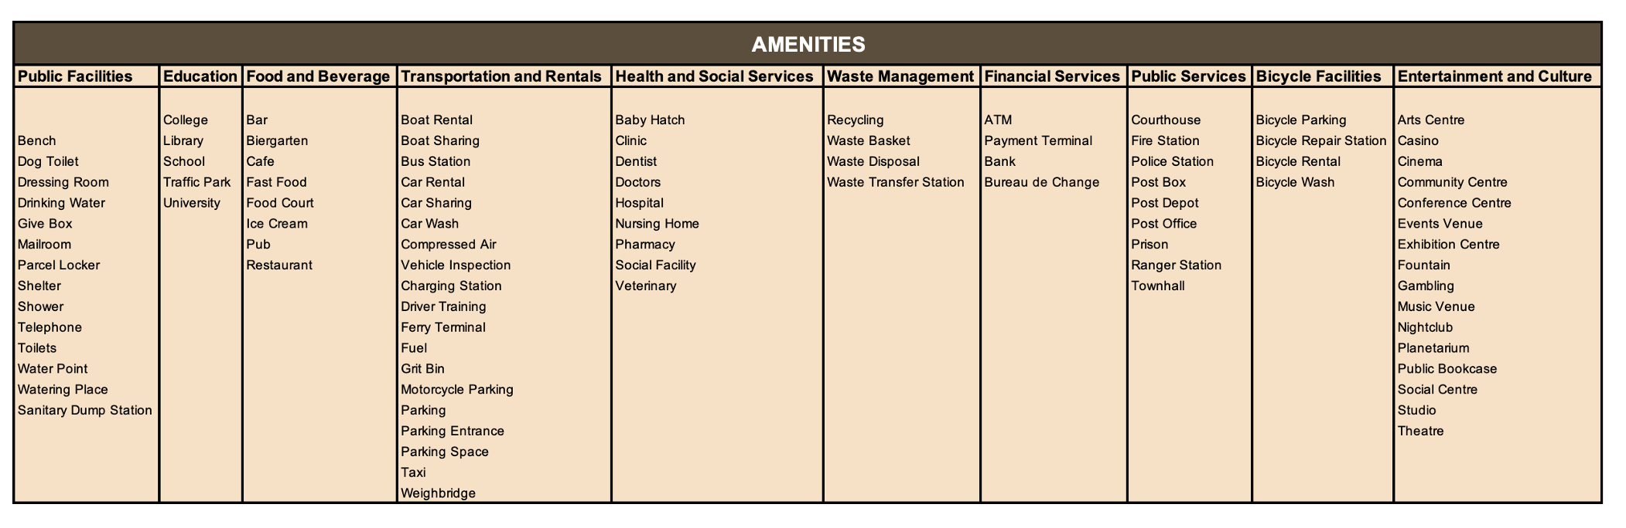
Nearby Places (To potentially identify ~200 nearby places)

Slide 7
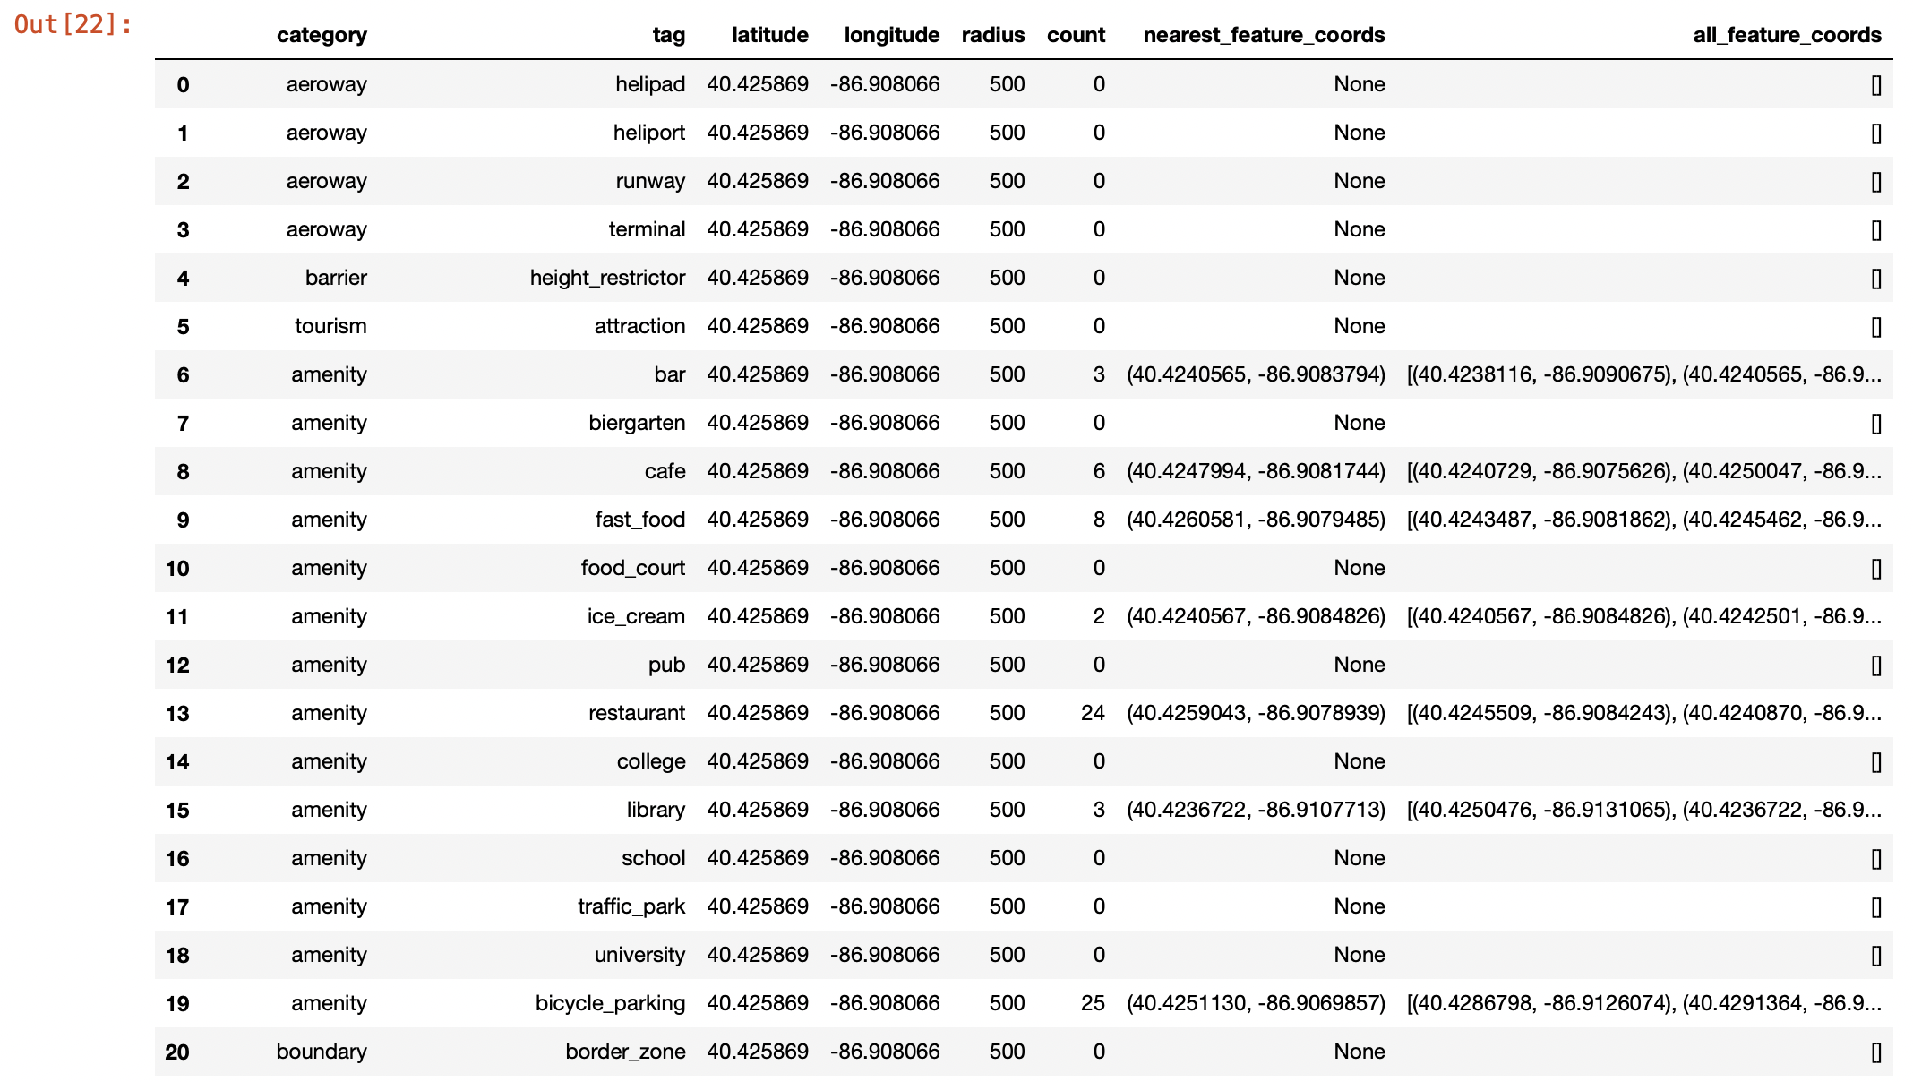
Nearby Places (To potentially identify ~200 nearby places)
OUPUT DATAFRAME:

Slide 8
Competitor Landscape in Each County

Slide 9



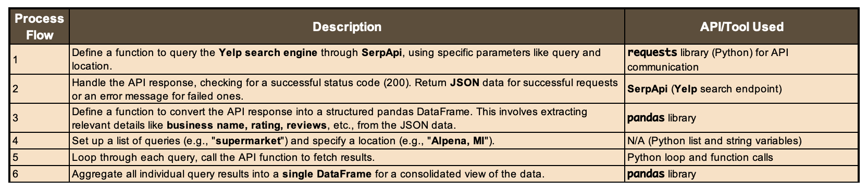
Competitor Landscape in Each County | Process Flow

Slide 10
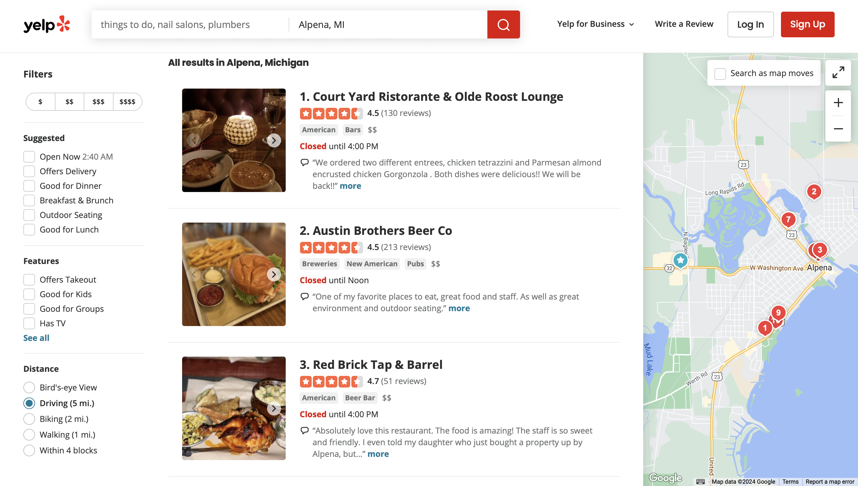
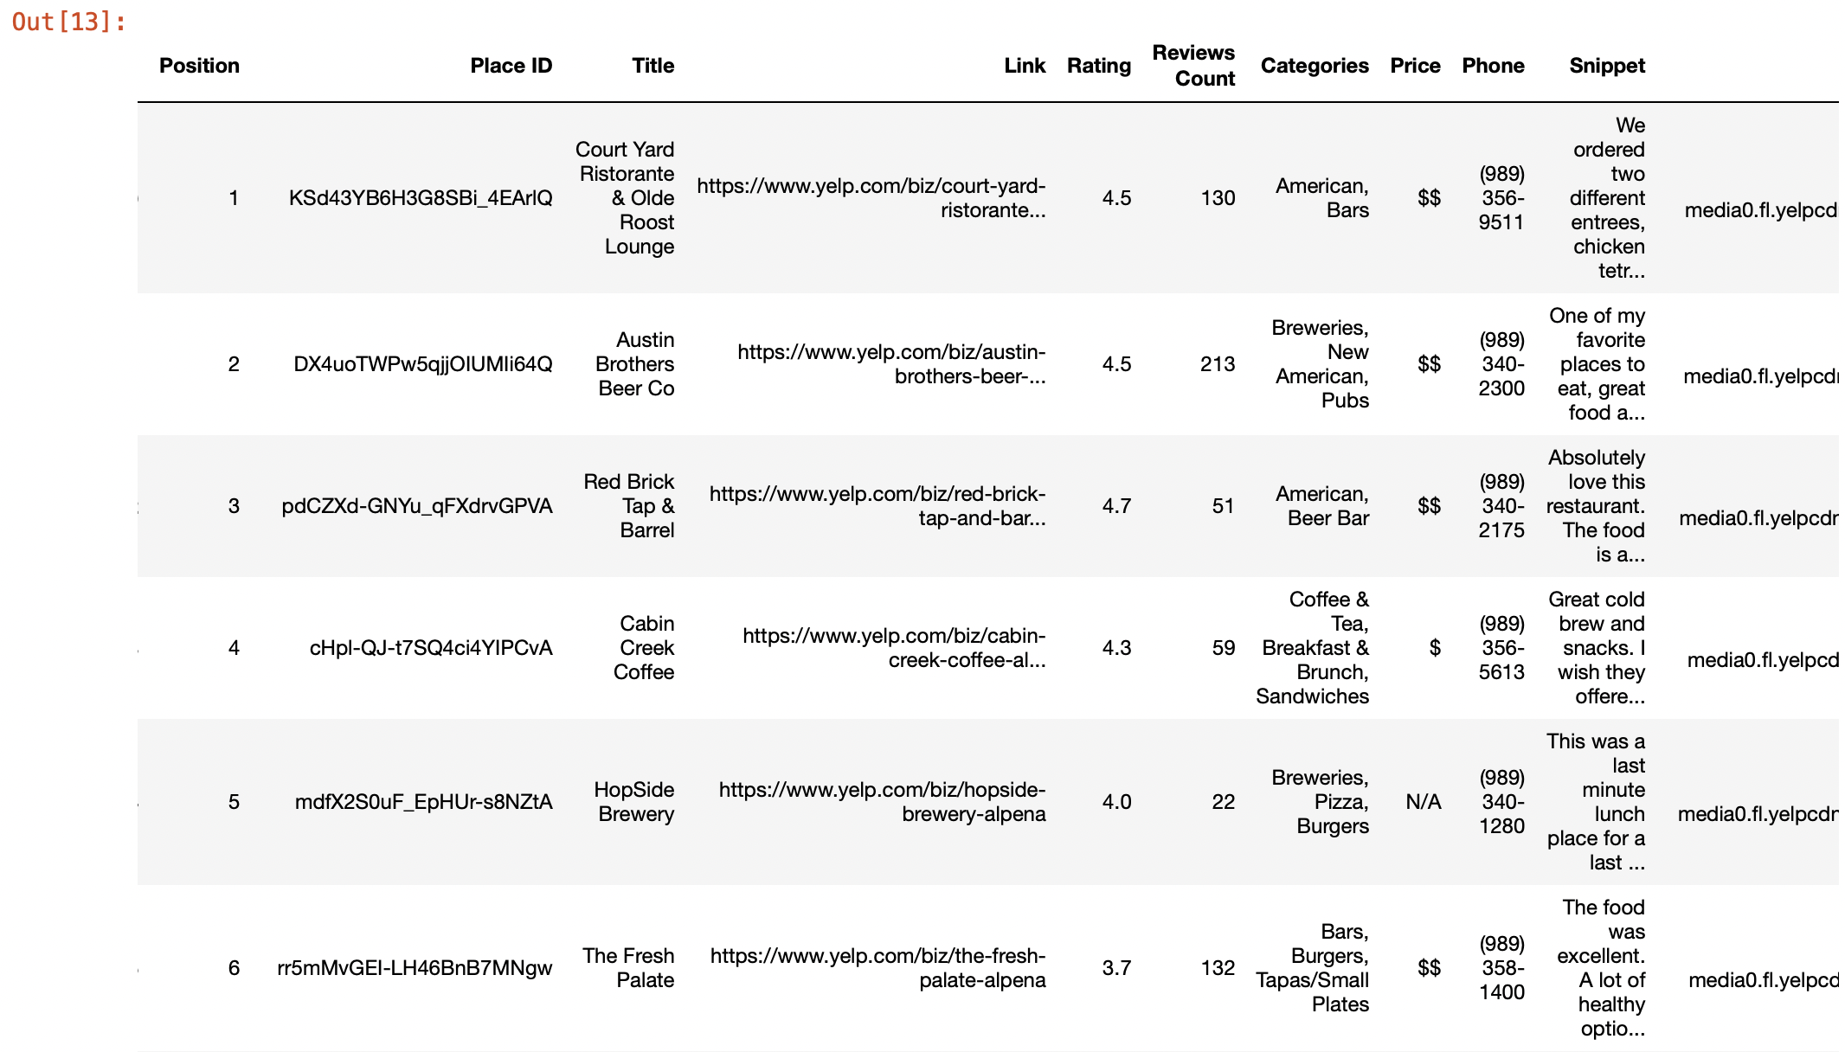
Competitor Landscape in Each County | All Businesses

Slide 11
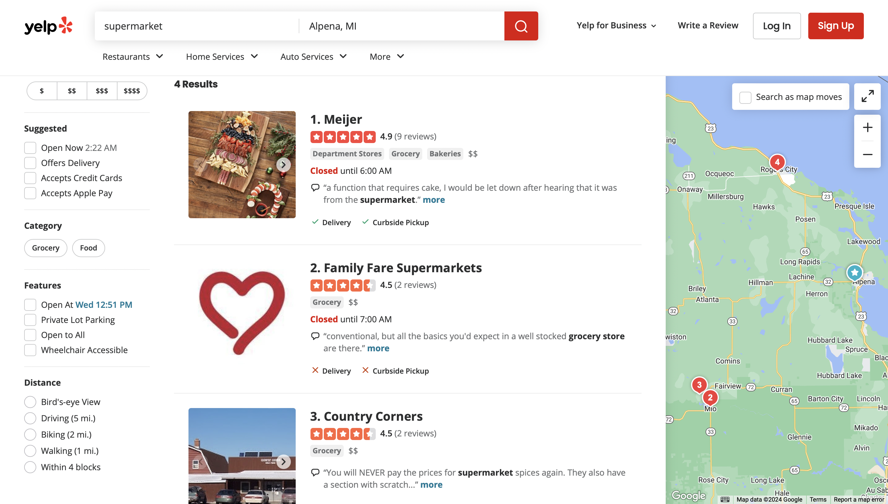
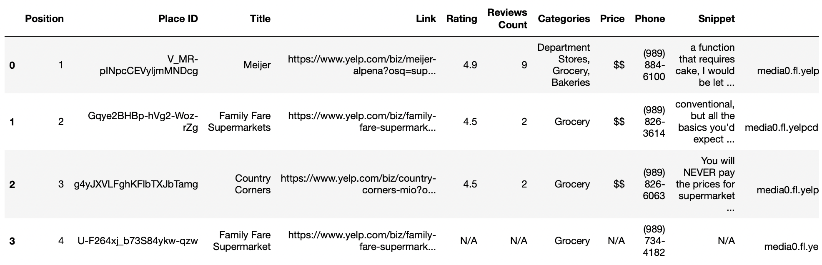
Competitor Landscape in Each County | Supermarkets

Slide 12
Sentiment Analysis

Slide 13

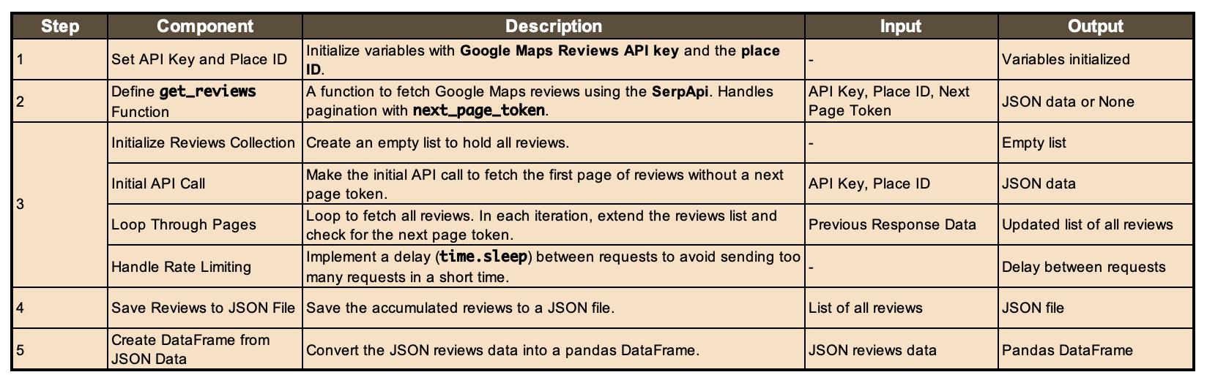
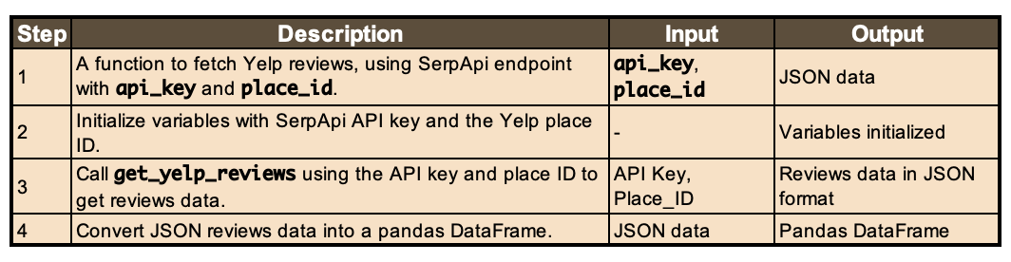
Sentiment Analysis | Yelp - Google Reviews | Scraping Reviews

Slide 14
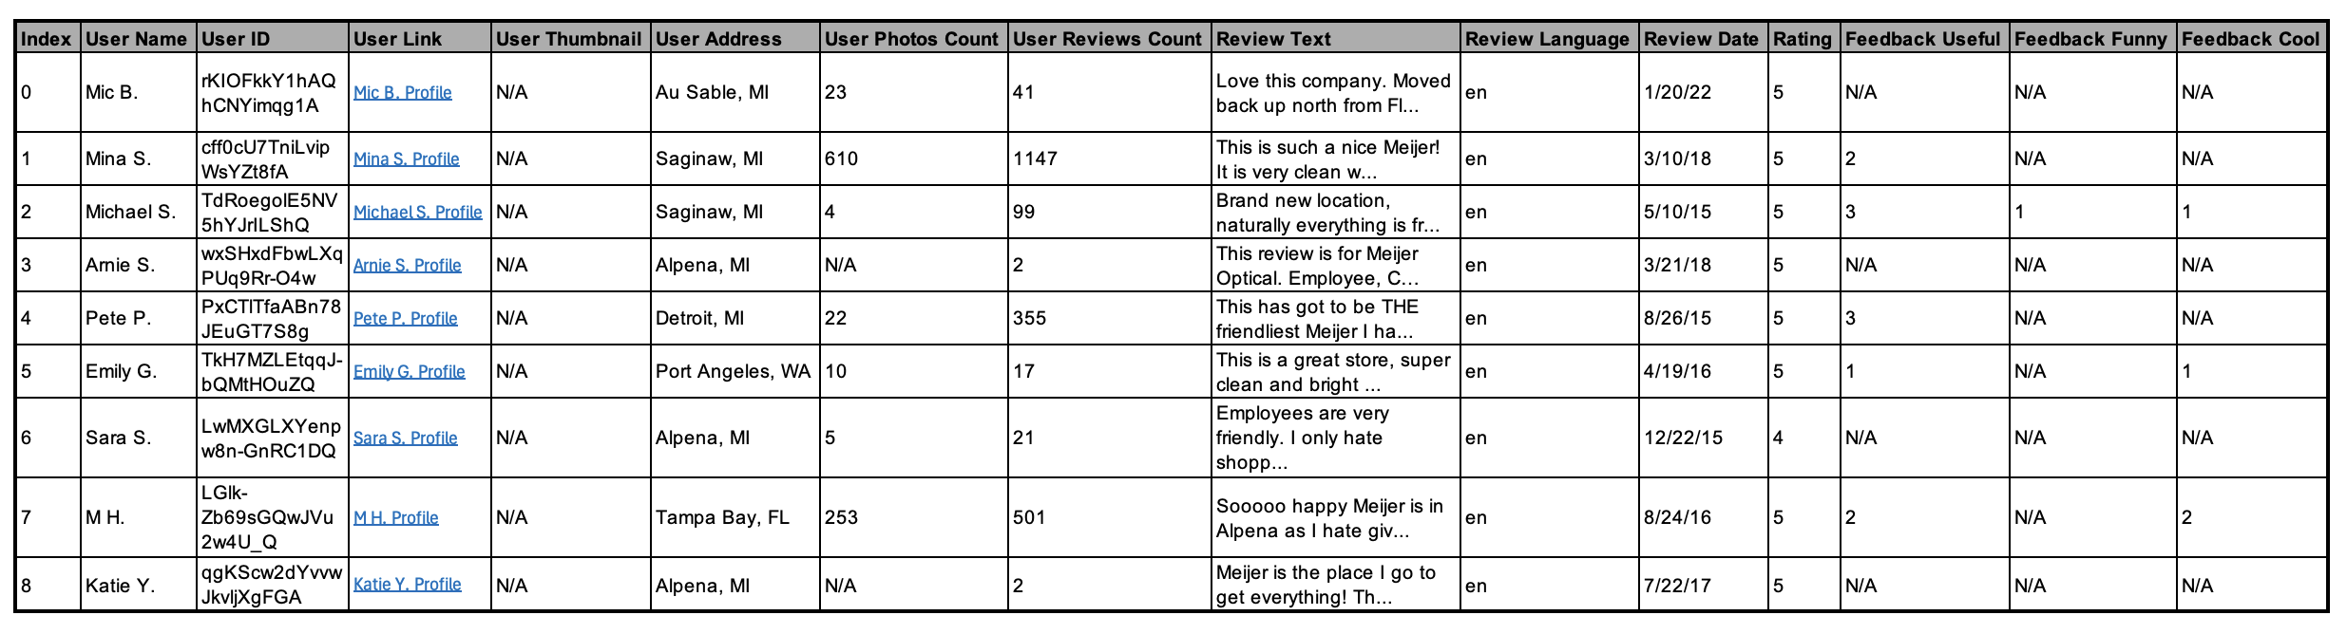
Sentiment Analysis | Yelp - Google Reviews | Sample Reviews Data-frame

Slide 15
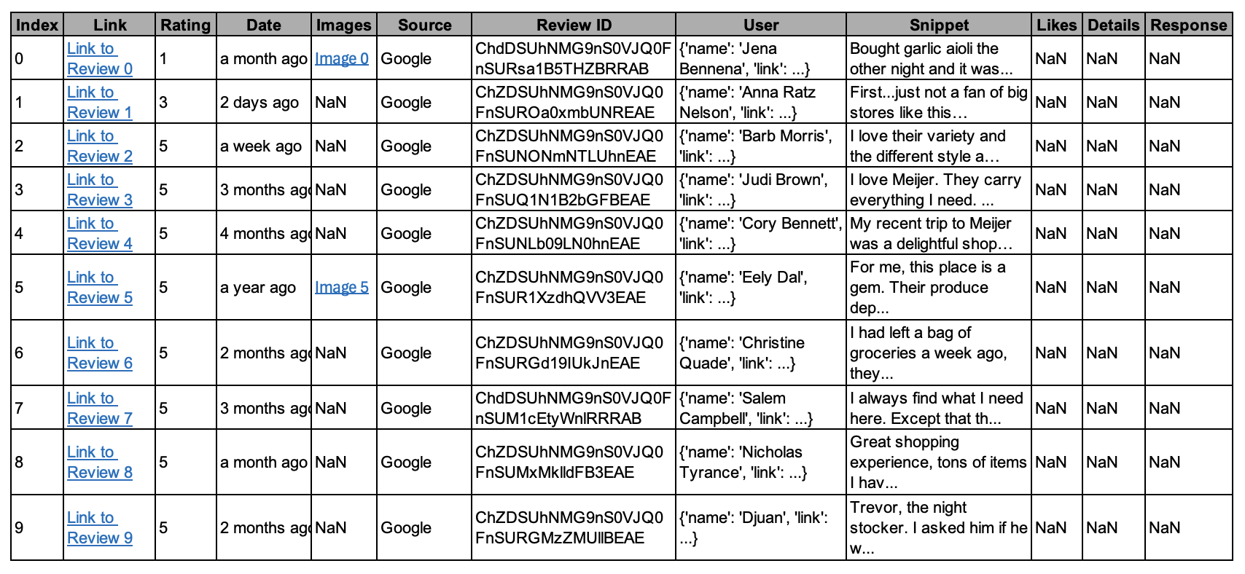
Sentiment Analysis | Yelp - Google Reviews | Sample Reviews Data-frame

Slide 16
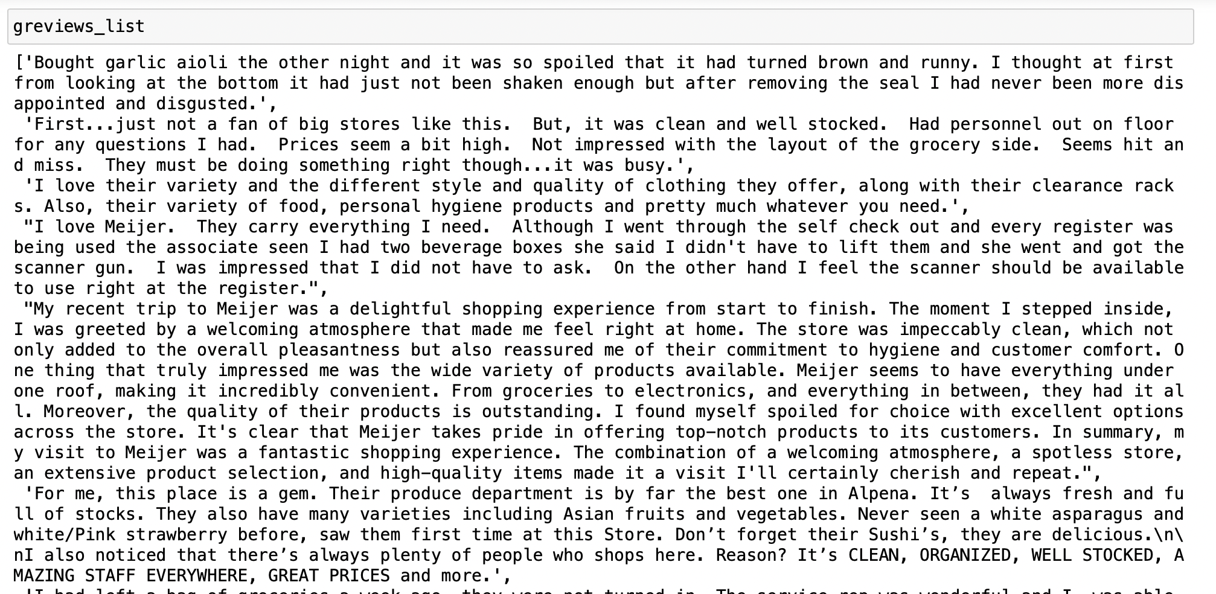

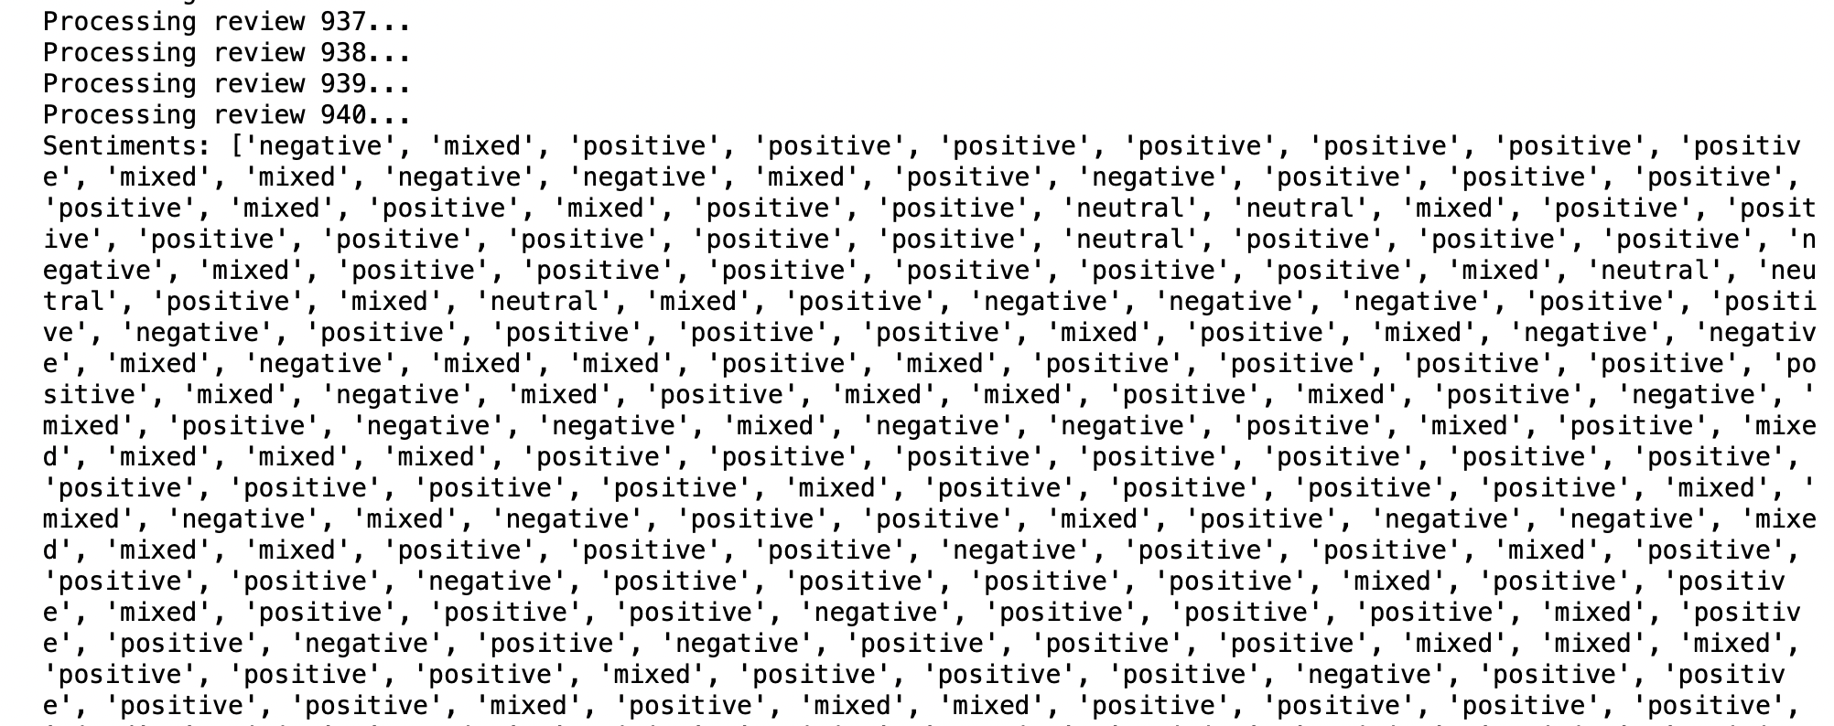
Sentiment Analysis | Yelp - Google Reviews | Analyzing Sentiments
A list containing the reviews text is fed into Azure Text Analytics API, which then returns the Sentiments of the respective text by classifying it as Positive, Neutral, Negative & Mixed
[Reviews] ----------------> Azure API ----------------> [Sentiments]

Slide 17

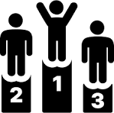



Sentiment Analysis | WHY?
Risk Management Negative sentiments can signal potential risks or issues that could also impact new stores. Proactively addressing these concerns can improve the chances of a new store's success
Local Preferences and Needs Sentiment analysis can help ensure that the new store aligns with the local community's expectations
Cultural Fit Customer reviews can provide insights into the cultural fit of Meijer in a community, which is crucial when entering markets with diverse populations
Brand Perception The sentiment surrounding the Meijer brand within a county is indicative of the brand's strength and market reception there, which is vital for the potential success of a new store
Competitive Insights
Analyzes competitive gaps, offering insights into where Meijer can fill market voids or capitalize on competitor weaknesses in new store locations

Slide 18
Meijer stores in Michigan

Slide 19
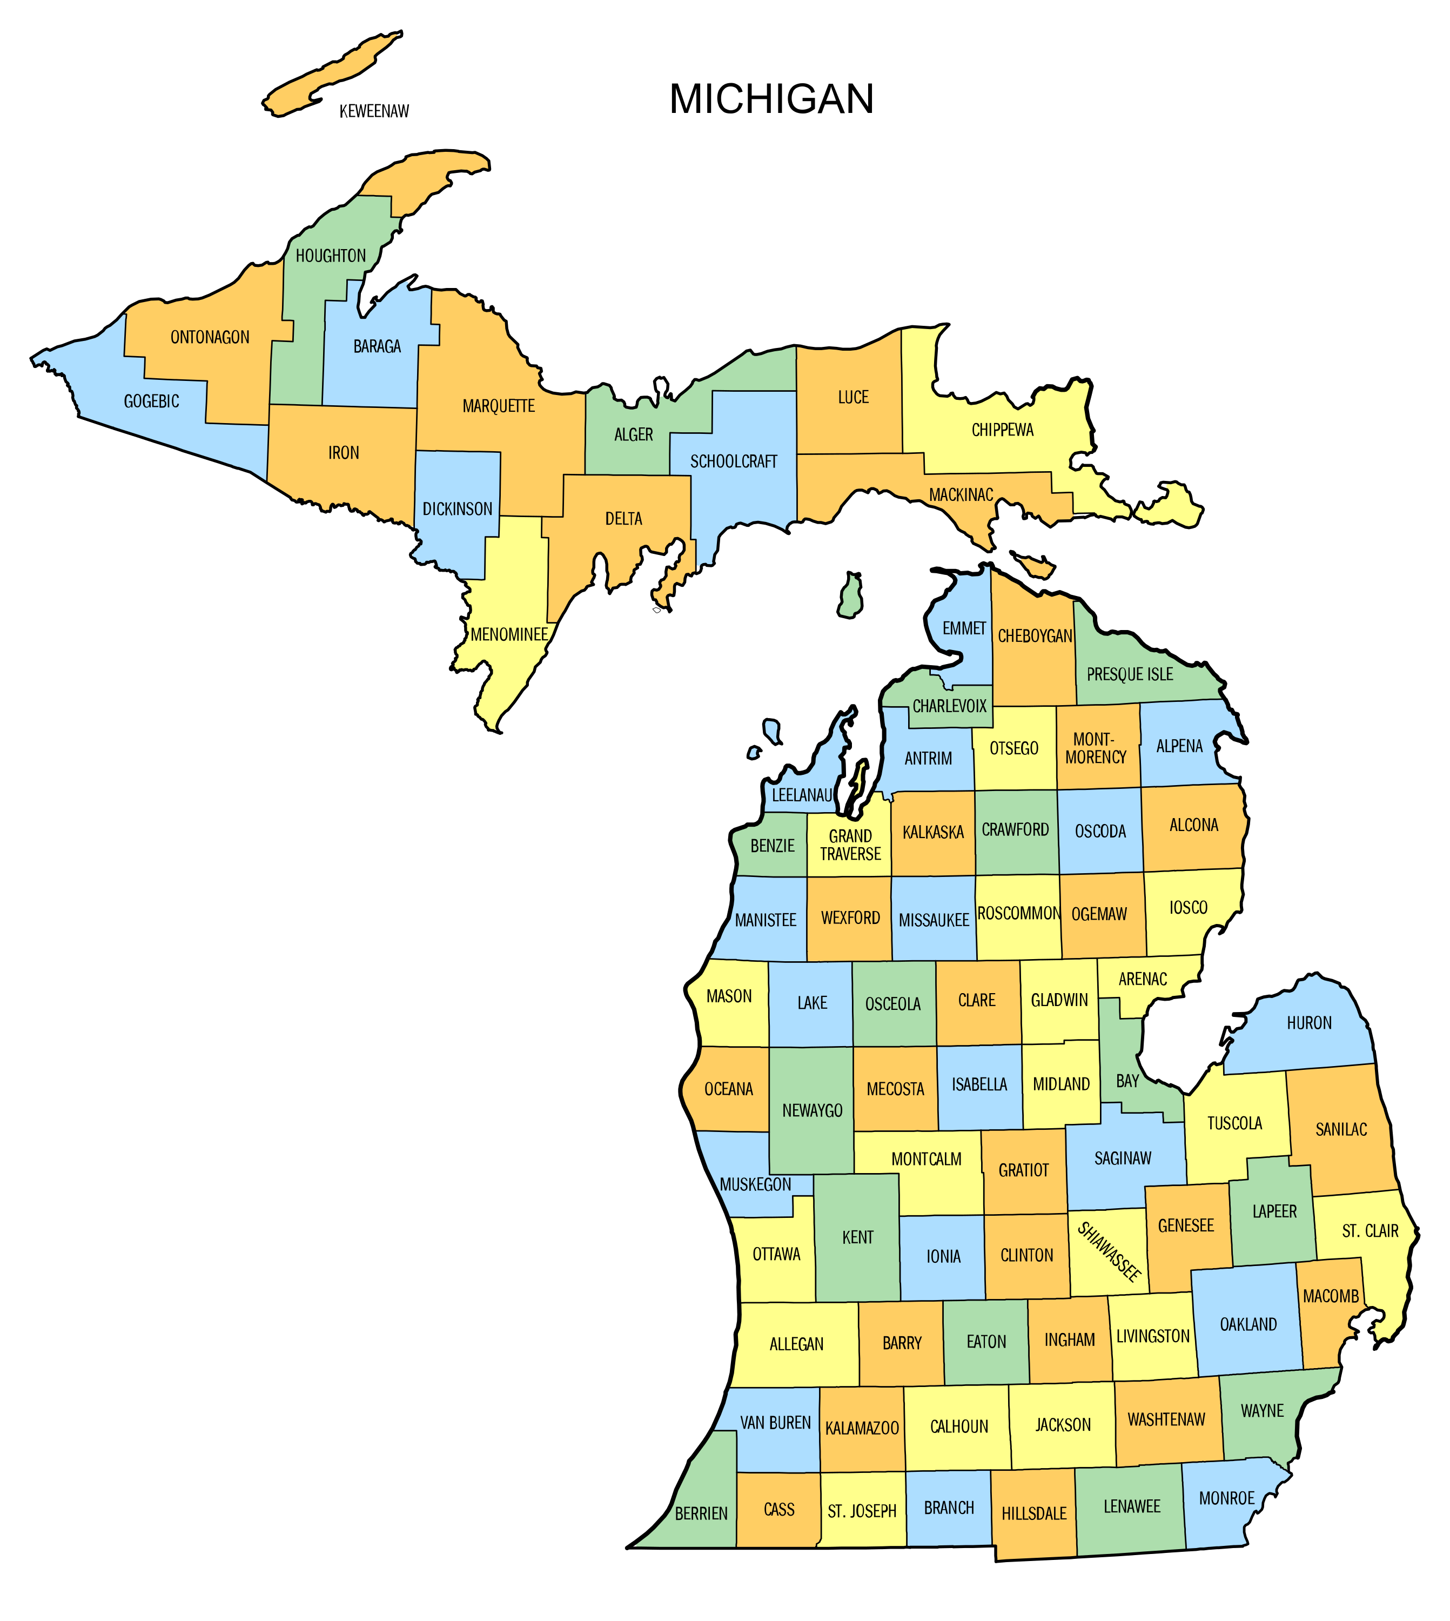
Meijer in Michigan
Types of Meijer Stores Identified
Michigan
Meijer Supercenter
Meijer Express
Meijer Bakery
Meijer Pharmacy
Meijer Deli
Meijer Grocery
Meijer Rivertown Market
Meijer Thrifty Outlet

Slide 20
Meijer in Michigan
Extent of Meijer Express Stores in Counties
Michigan
Alcona
Alger
Antrim
Arenac
Barry
Benzie
Berrien
Calhoun
Cass
Chipewa
Crawford
Eaton
Ingham
Kent
Luce
Mackinac
Mason
Mecosta
Missaukee
Montcalm
Muskegon
Newaygo
Oakland
Ottawa
St. Clair
St. Joseph
Sanilac
Tuscola
Washtenaw
Wayne

Slide 21
Meijer in Michigan
Attributes Scraped for each Meijer store
Michigan
Latitude & Longitude
County
Proximity to Supercenter
(For Meijer Express)
Traffic Volume
Nearest Highway Entrance
Distance + Duration
Number of Bus stops
Number of Restaurants

Slide 22
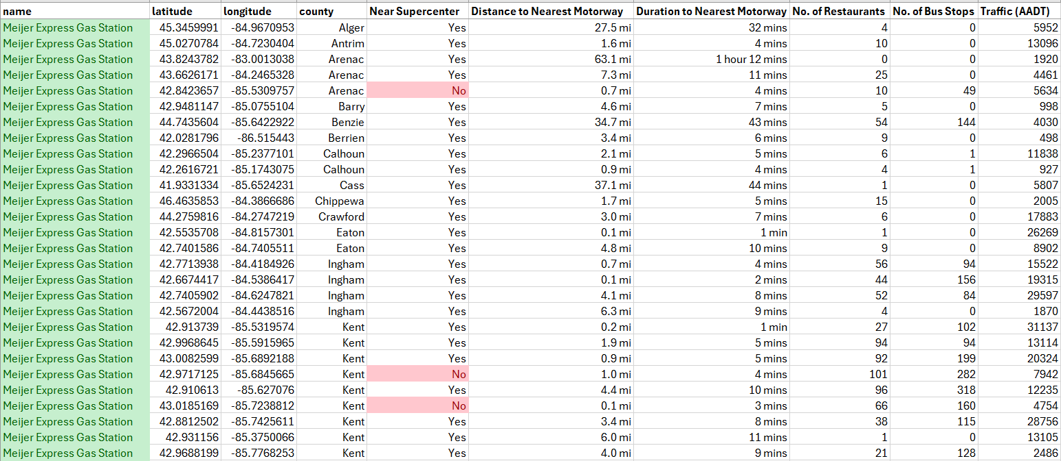
Dataset for Meijer stores in Michigan

Slide 23
competitor convenience stores

Slide 24
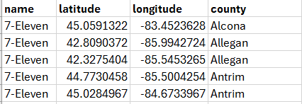
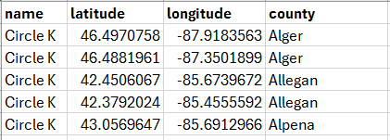
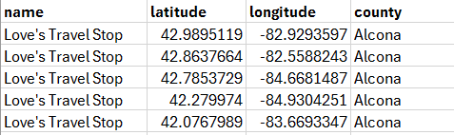
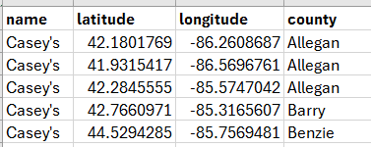
Competitor convenience stores
7-Eleven
Circle K
Love's
Casey's

Slide 25
Meijer vs Competitors Data Visualization

Slide 26
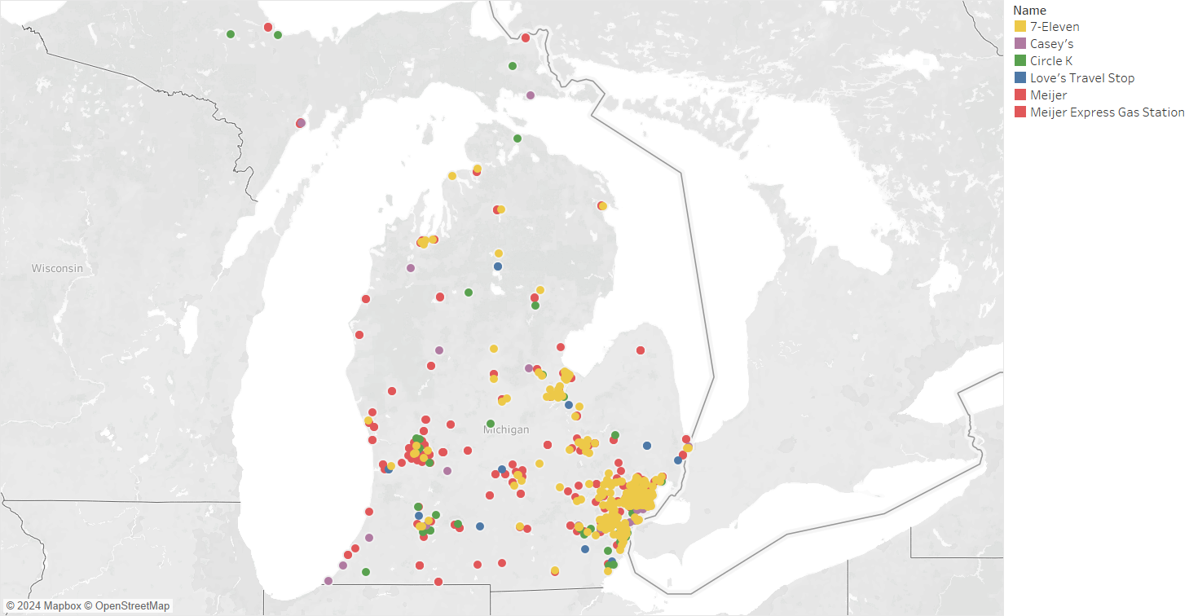
Convenience Store Landscape in Michigan
All Store Locations

Slide 27
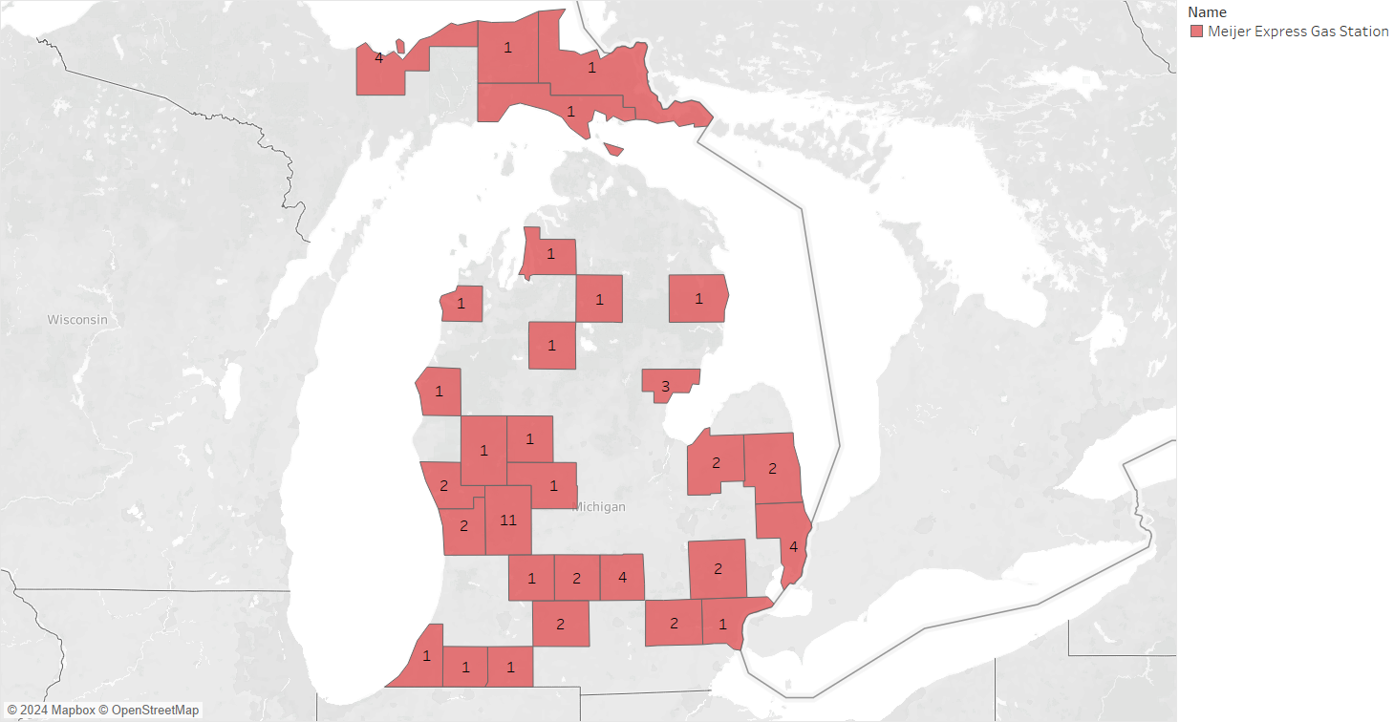
Convenience Store Landscape in Michigan
Meijer Express Counties

Slide 28
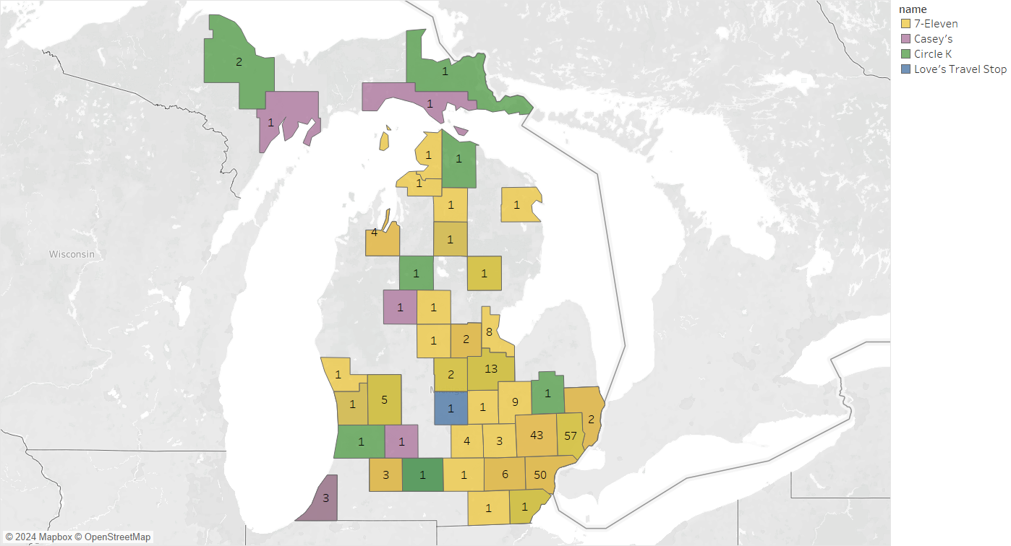
Convenience Store Landscape in Michigan
Competitor Counties

Slide 29
Questions/Next Steps

Slide 30
Questions / Next Steps
Questions
Will we be able to use Nielson’s data?
What are some of the other features that should be considered relevant? Does Meijer have a preference?
Next Steps
Building a master dataset by combining data points from different features and assigning them to each of the location IDs (latitude & longitude)
Determine a scoring system for each of the factors
Explore other relevant features that would help in building the scoring algorithm

Slide 31
THANK YOU

Slide 32
Appendix

Slide 33
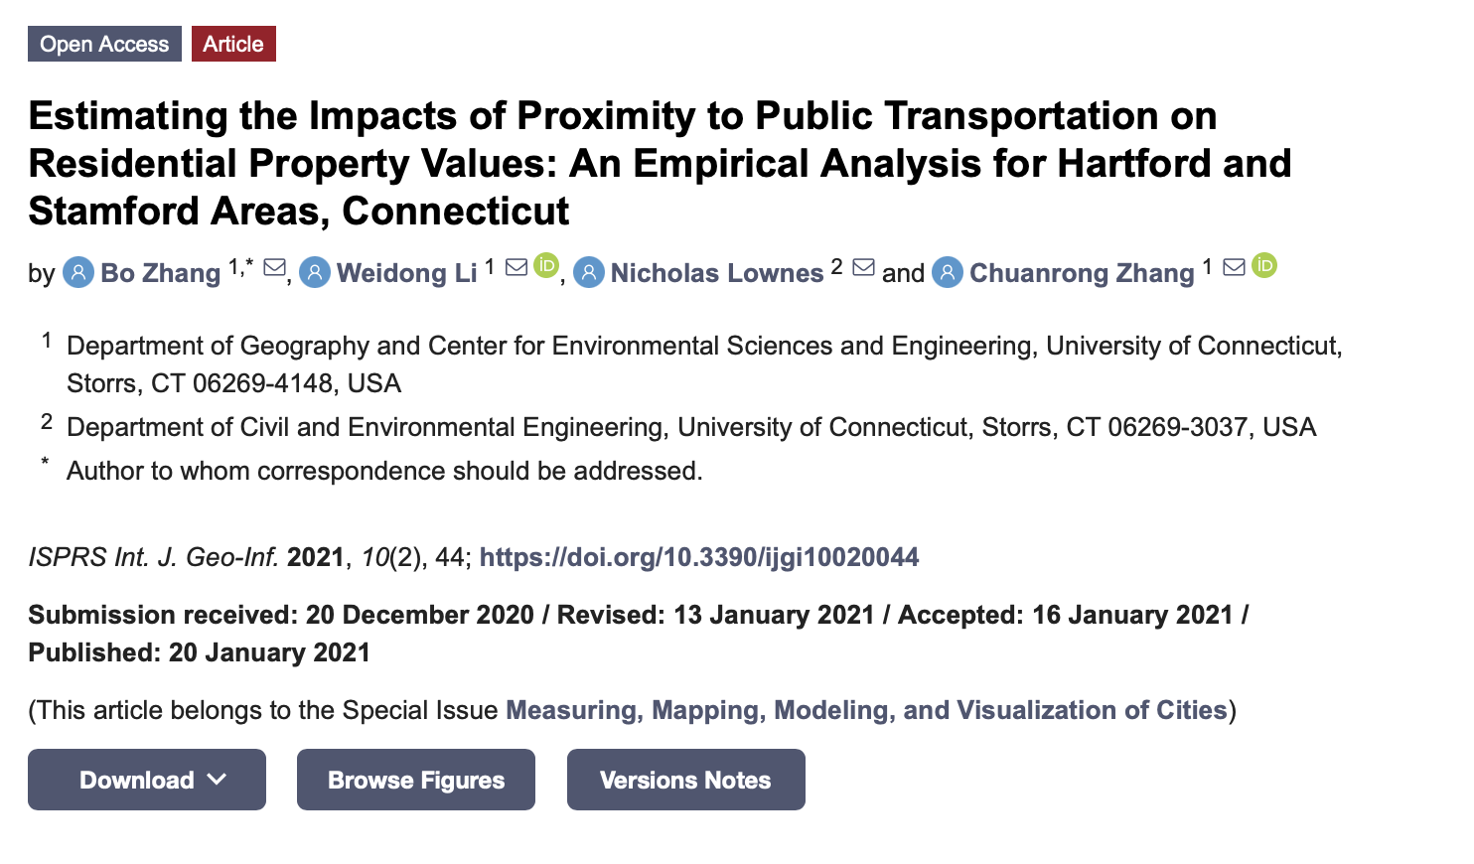
Reference Material: Research Paper Publication

Slide 34





Meet the Team
Harshraj Jadeja | Srinija S | Veda Samhitha Alluri | Husam Saleh | Shubhankar Bhajekar
Data science consultant with 4.5 years of analytical experience in retail, healthcare and telecom industry | Data Engineer with 4 years of experience in ETL and analytics in the banking industry | Data Consultant with 3+ years of experience, skilled in data migration, performance optimization, and compliance. | Aspiring Data Consultant with analytical experience in public sector and finance industry | Business Analytics student with 2.5 years of experience in construction and real estate.
hjadeja@purdue.edu | ssrimami@purdue.edu | alluriv@purdue.edu | hasaleh@purdue.edu | Sbhajeka@purdue.edu
https://www.linkedin.com/in/Harshraj-jadeja/ | www.linkedin.com/in/srinija-s | www.linkedin.com/in/veda-samhitha-alluri | www.linkedin.com/in/husam-saleh-421hs | https://www.linkedin.com/in/shubhankar-bhajekar/

Slide 35
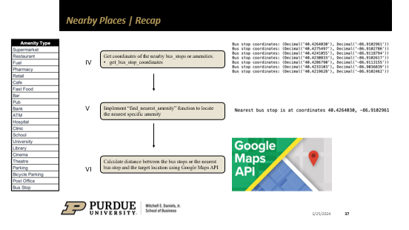
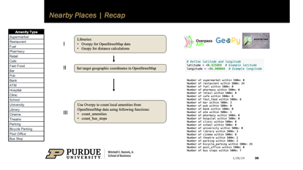

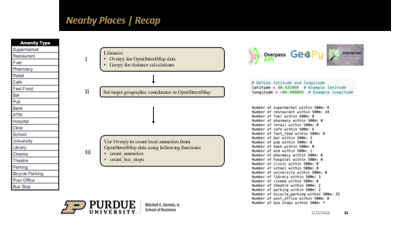
Nearby Places | Recap

Slide 36
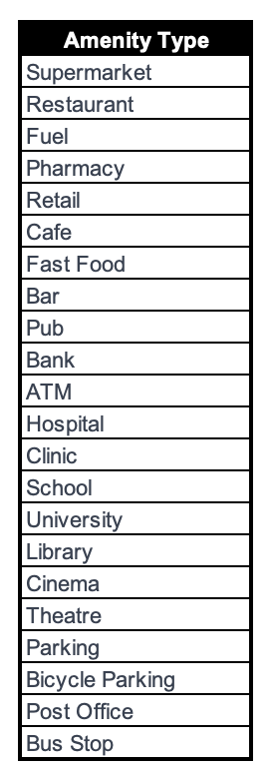
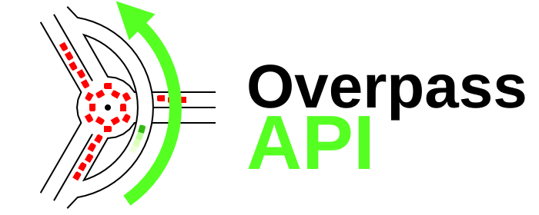


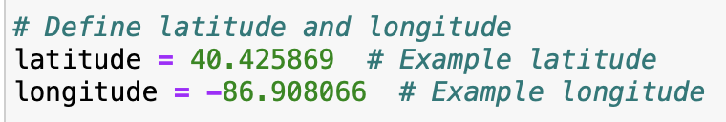
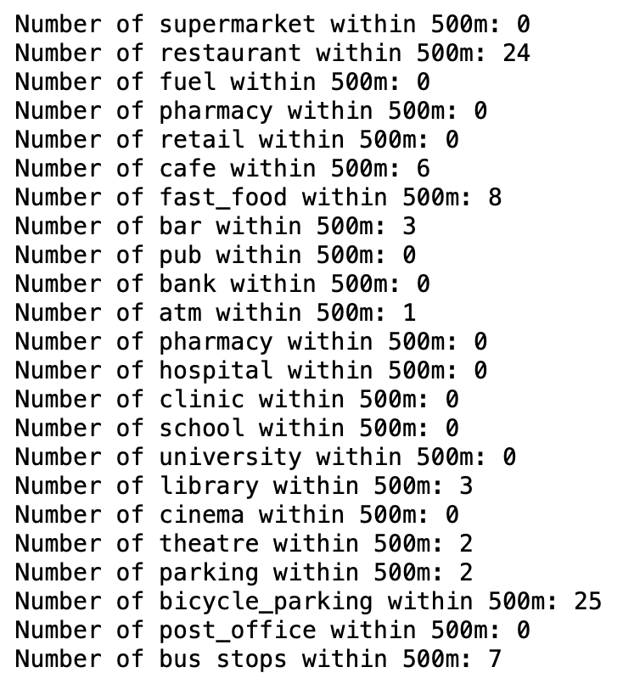
Nearby Places | Recap
Libraries:
Overpy for OpenStreetMap data
Geopy for distance calculations
I
II
Set target geographic coordinates in OpenStreetMap
Use Overpy to count local amenities from OpenStreetMap data using following functions:
count_amenities
count_bus_stops
III

Slide 37
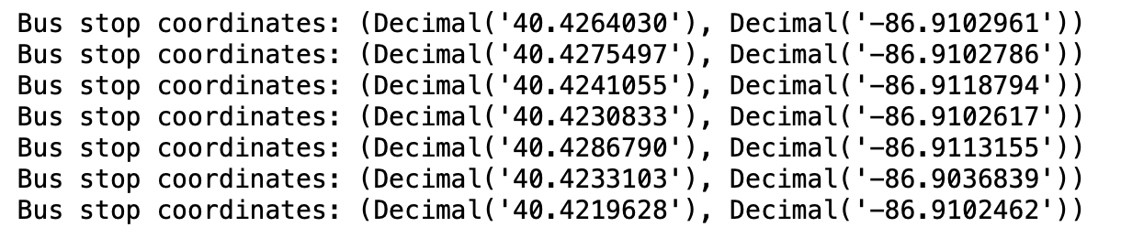
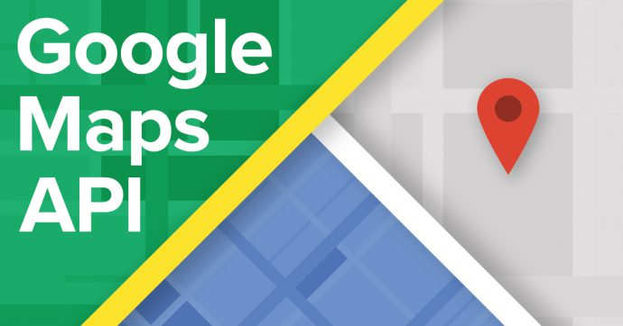
Nearby Places | Recap
Get coordinates of the nearby bus_stops or amenities.
get_bus_stop_coordinates
IV
V
Implement “find_nearest_amenity” function to locate the nearest specific amenity
Calculate distance between the bus stops or the nearest bus stop and the target location using Google Maps API
VI

